Slide 1
Deep Learning
TECHNICAL WORKSHOP

Slide 2

Hello!
Let’s Learn
Deep Learning
Vidyasagar Nallapati,
Naveen Bhansali,
Jitendra Rudravaram

Slide 3
WHAT
1
Deep Learning

Slide 4
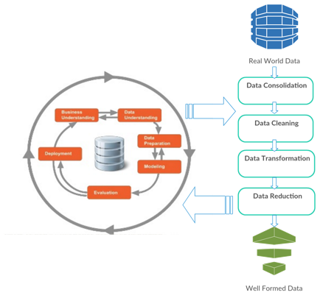
Learning
Patterns

Slide 5
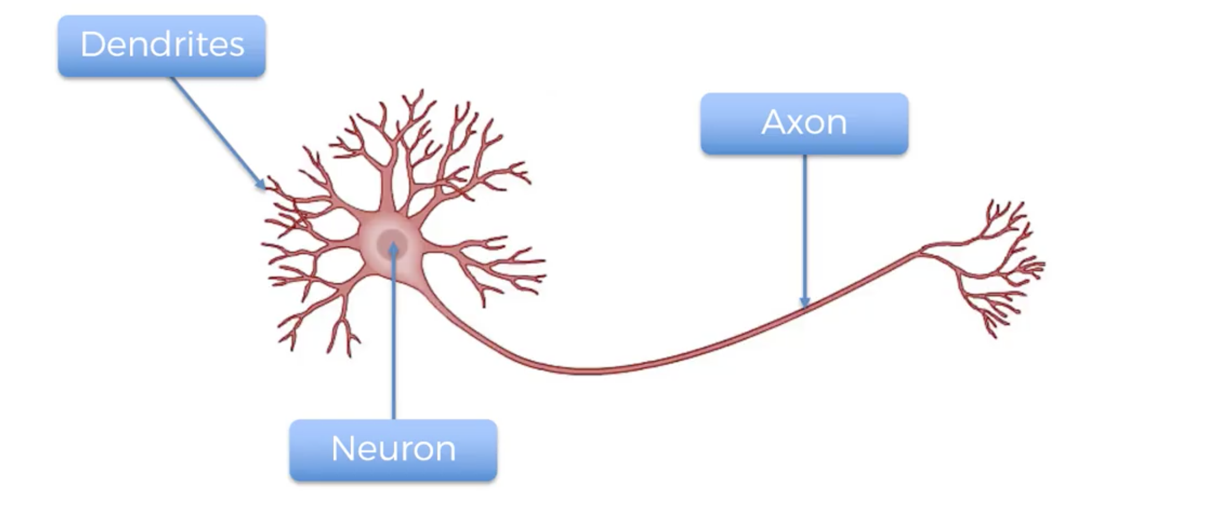
Learning Structure – Biology

Slide 6
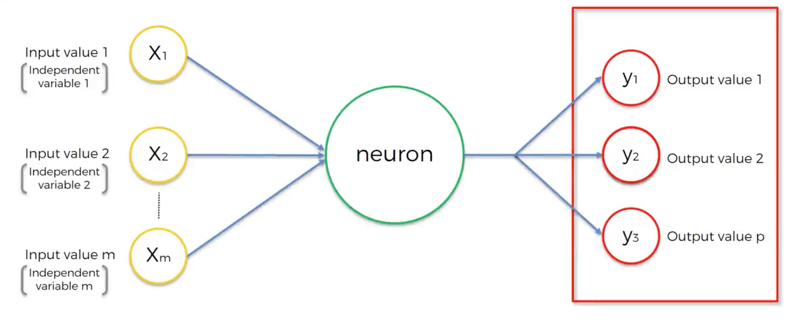
Learning Structure – Neural Network

Slide 7
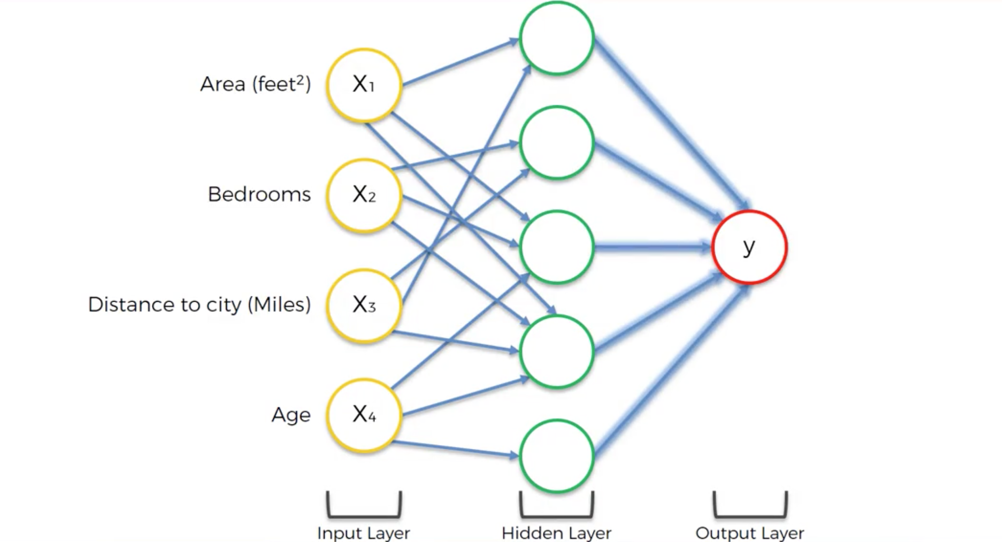
Learning in Layers – Deep Neural Network

Slide 8
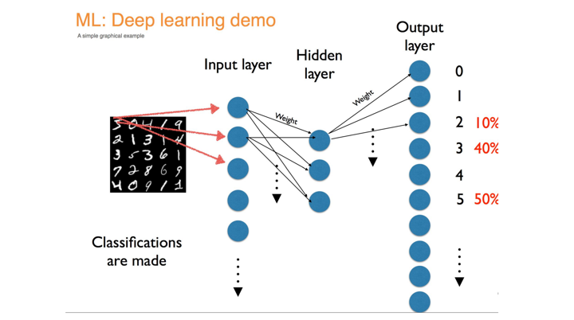

Slide 9
WHY
2
Deep Learning

Slide 10
“
“Just as electricity transformed almost everything 100 years ago, today I actually have a hard time thinking of an industry that I don’t think AI will transform in the next several years”
Andrew Ng

Slide 11
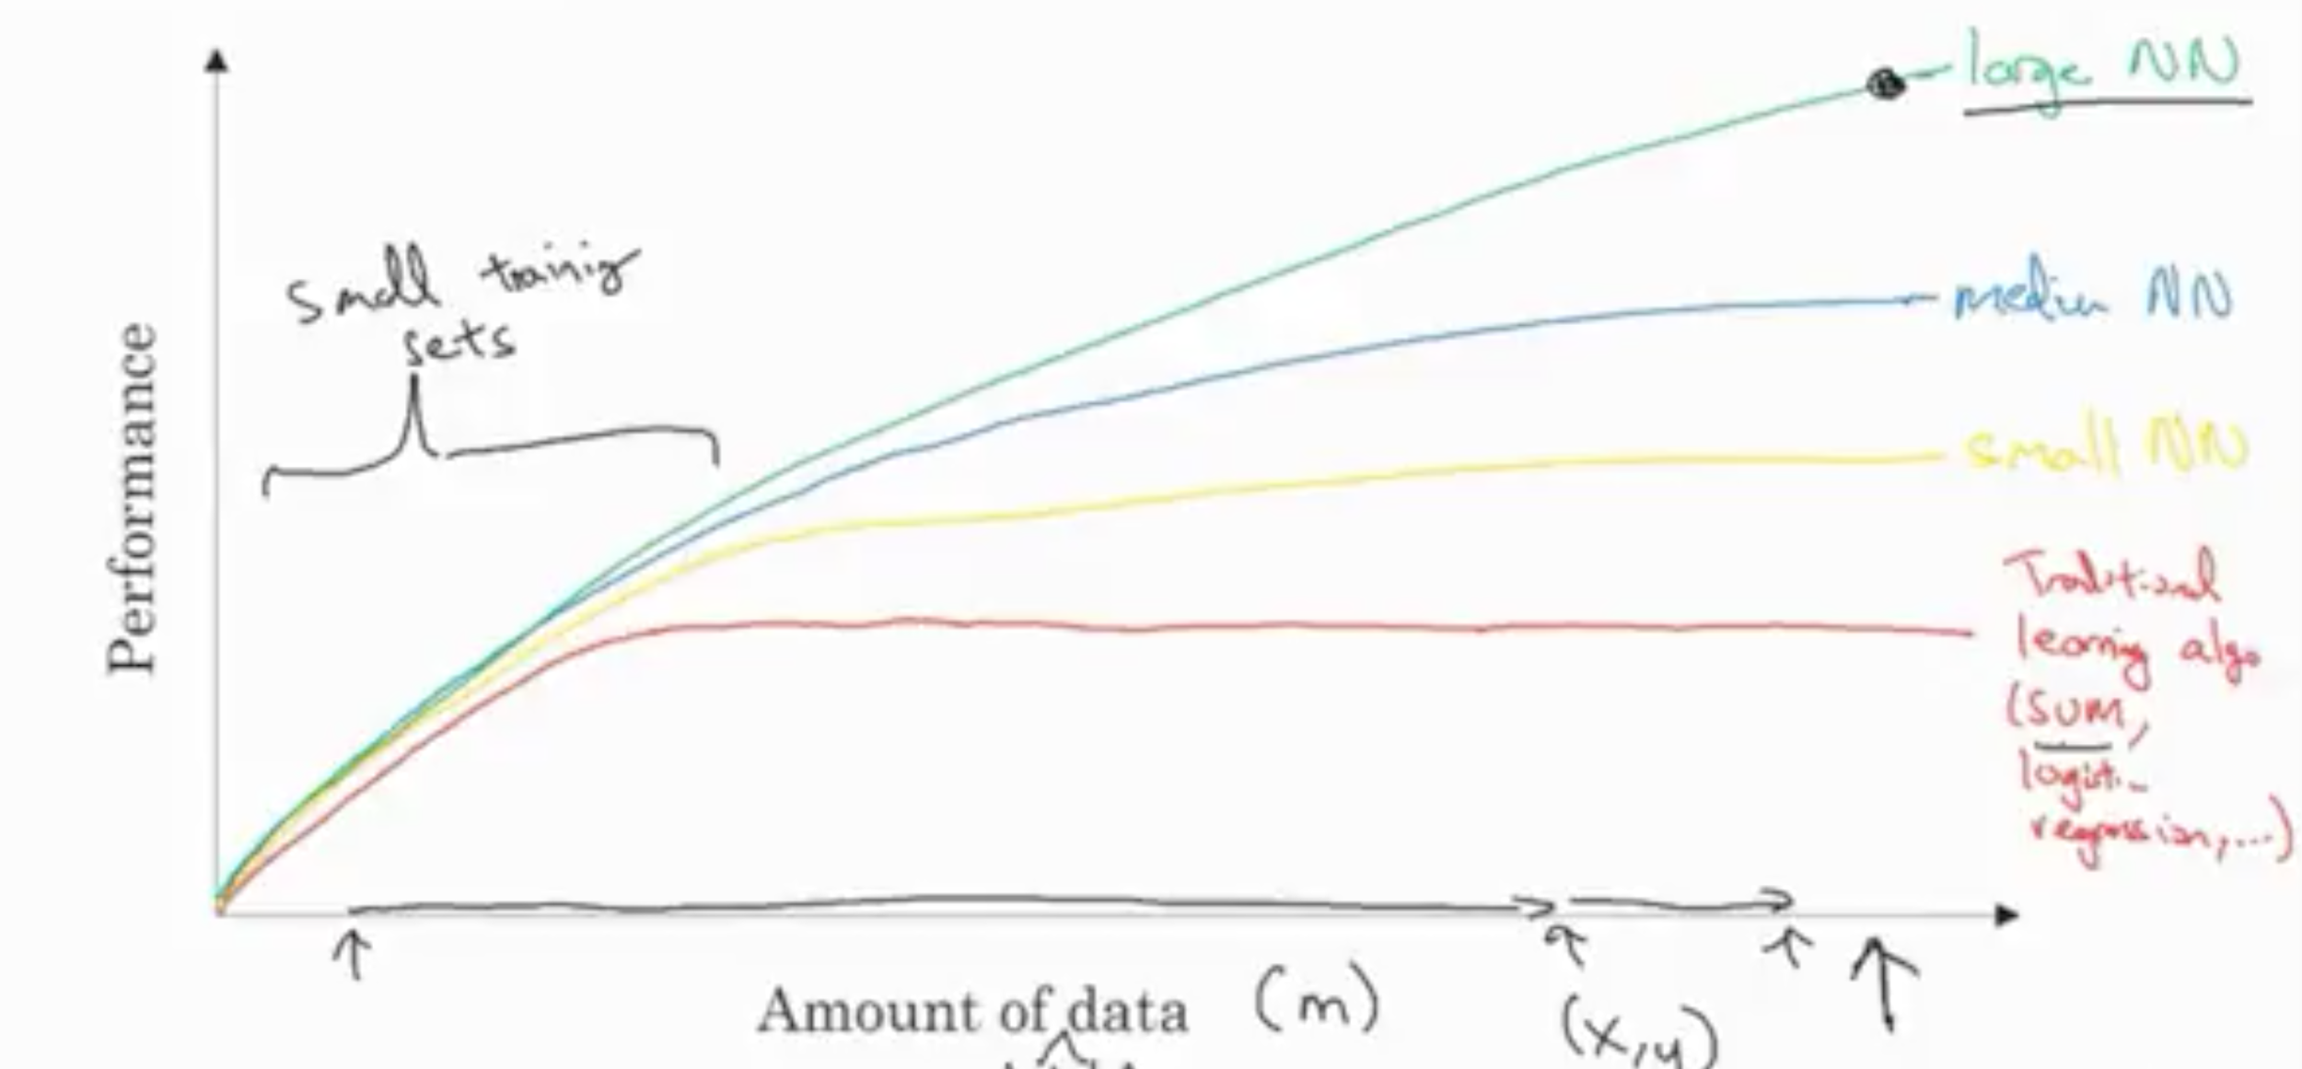
Why Deep Learning Now?
1) Data
2) Computation
3) Algorithms

Slide 12
How
3
Deep Learning

Slide 13
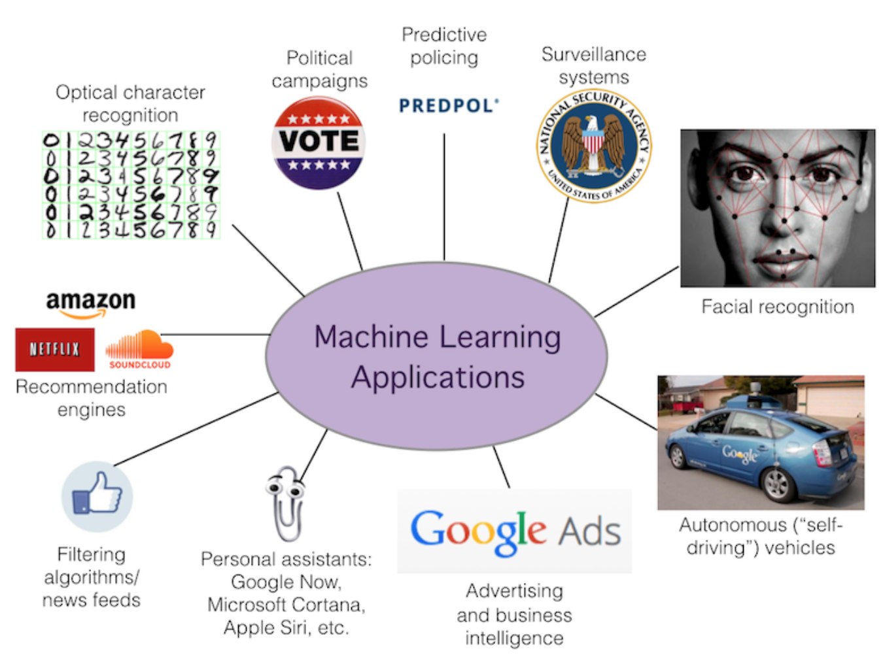
Computers can Learn

Slide 14
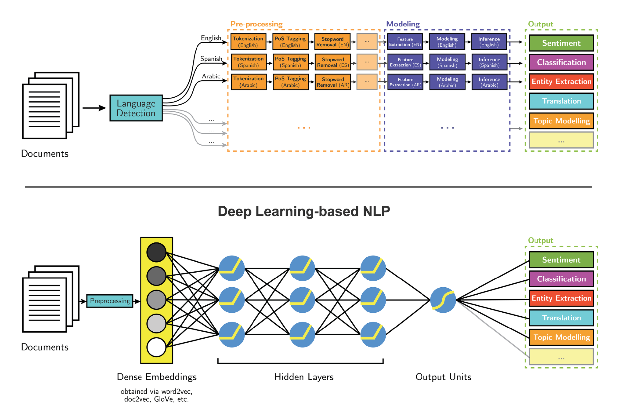
Computers can Listen

Slide 15

Computers can See

Slide 16
Essentials
Deep Learning

Slide 17
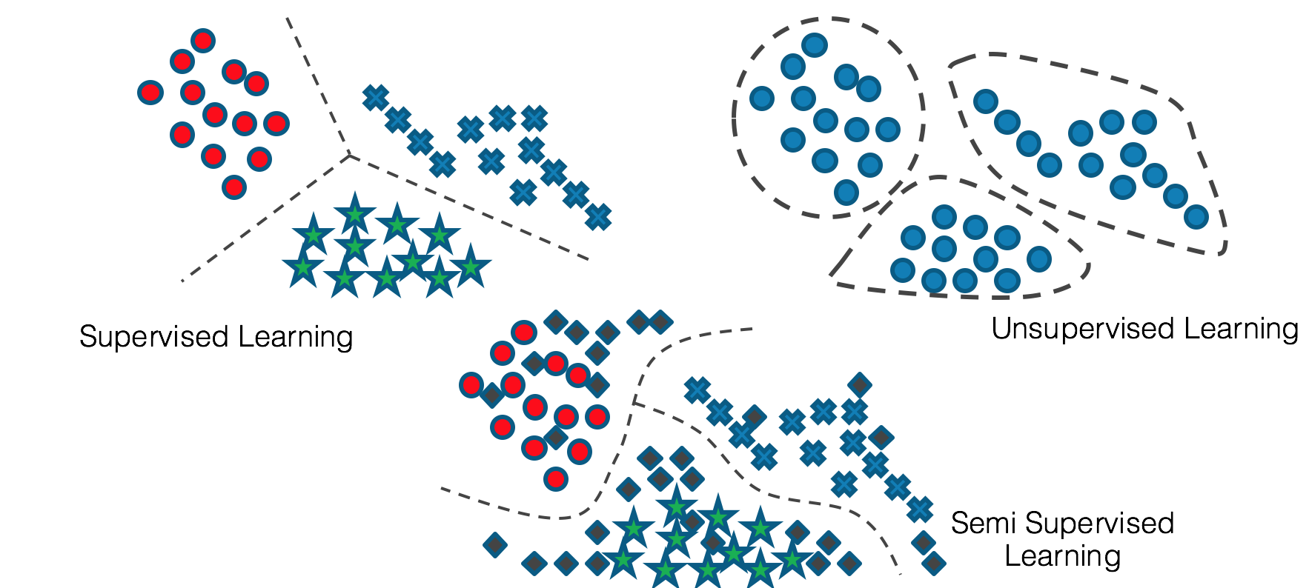
Types of Learning

Slide 18
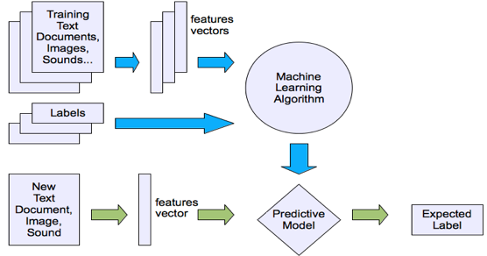
Supervised Learning
Each example has some features/characteristics
Each example has an output
We attempt to learn the relationship between the set
of features and the output
If the output is a numeric then this is Regression
If the output is a category then this is Classification

Slide 19
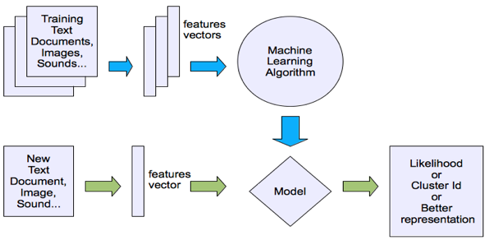
Un-Supervised Learning
Each example has some features/characteristics
We attempt to learn patterns in the data by looking at the features.
Examples can be grouped together based on similarity in features.

Slide 20
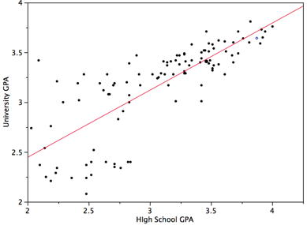
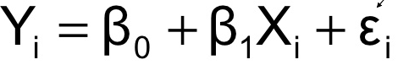
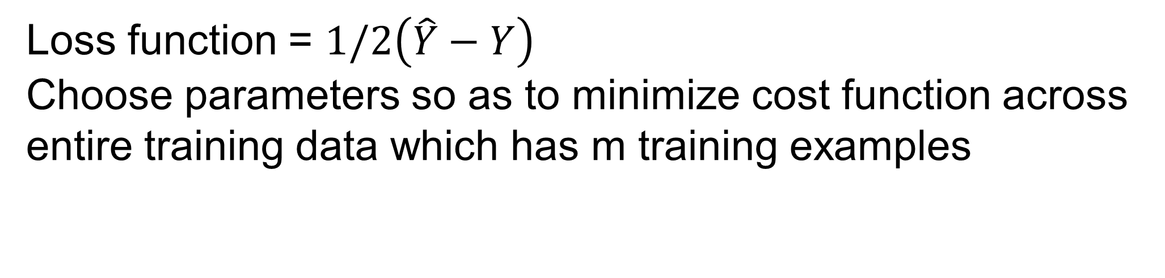
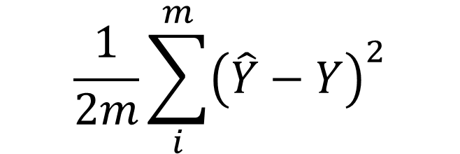
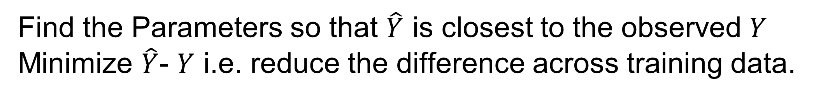
Supervised Learning - Regression
A university wants to determine if High School GPA can be used to predict University GPA
Regression is a type of supervised learning where we identify the relationship between the features or characteristics with a continuous numeric output.
If the relationship is linear it is called Linear Regression
If we use only one feature it is called Simple Linear Regression, If we use multiple features it is called Multiple Linear Regression.
Find the Parameters
Find the Parameters so that $\hat{Y}$ is closest to the observed $Y$
Minimize $\hat{Y}$- $Y$ i.e. reduce the difference across training data.
Loss function = $1/2\left(\hat{Y}−Y\right)$
Choose parameters so as to minimize cost function across entire training data which has m training examples
$$\frac{1}{2m}\sum_{i}^{m}{{\left(\hat{Y}−Y\right)}^{2}}$$

Slide 21
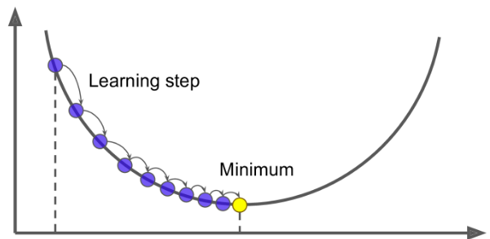
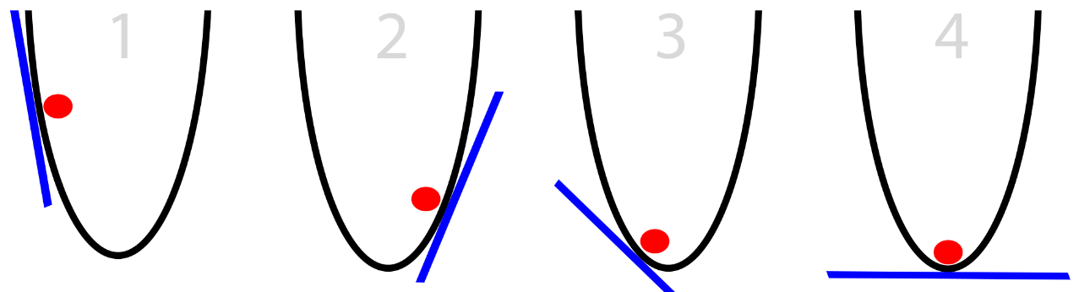
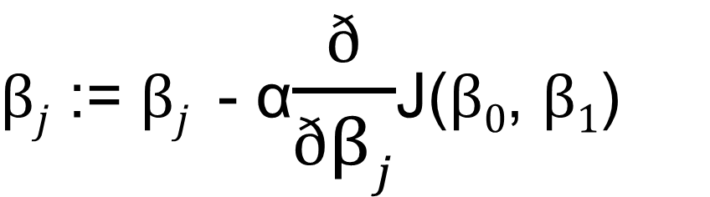
Regression - Gradient Descent
Each possible line (linear relationship) gives a corresponding value for the cost function. If we were to plot the cost function it would follow a convex shape.
The lowest point in this convex shape corresponds to the lowest value the cost function can take and in turn corresponds to the best linear relationship possible.
So basically start with some value of parameters calculate cost function, keep changing parameters till we reach lowest value.
Derivative/Gradient of a function is rate of change in Y given a very small change in X. When the derivative is zero we are at lowest value of a convex function.
So start with some value of parameters, calculate cost function. calculate the derivative of the cost function and use the learning rate to change the parameter value. Keep repeating till convergence i.e. negligible change in derivative.
Gradient descent is a methodology to reach this optimal value.
Repeat until convergence {
}
$βj$ := $βj$ - α$\frac{ð}{ðβj}$J($β0$, $β1$)

Slide 22
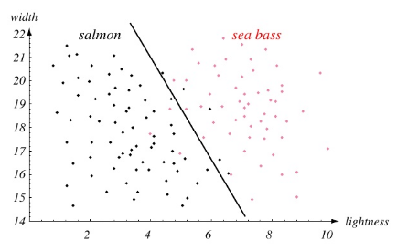
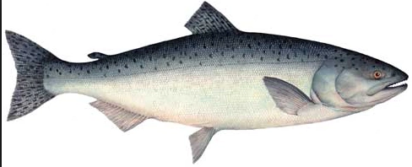
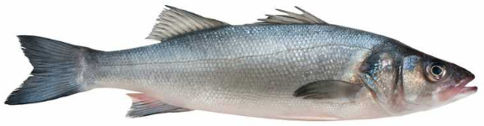
Supervised Learning - Classification
A fish packing plant wants to automate the process of sorting incoming fish on a conveyor according to species using optical sensing
Classification is a type of supervised learning where we identify the relationship between the features or characteristics with category/label.
A variation of Regression called Logistic Regression can be used for Classification.
If we have only two labels it is called Binomial Logistic Regression and if we have multiple labels it is called Multinomial Logistic Regression.
In Binomial Logistic regression the output can be either of the two label and if we represent the labels as 1 and 0, in this case the output can be between 0 and 1. We cannot use linear regression since its output is continuous and we will require a relationship which bounds the output to between 0 and 1.

Slide 23
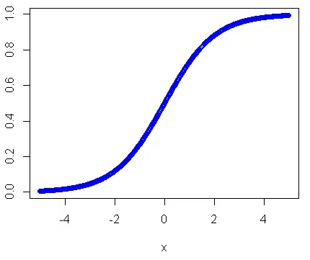
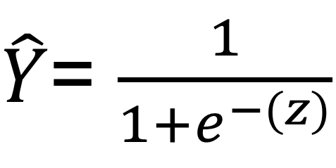
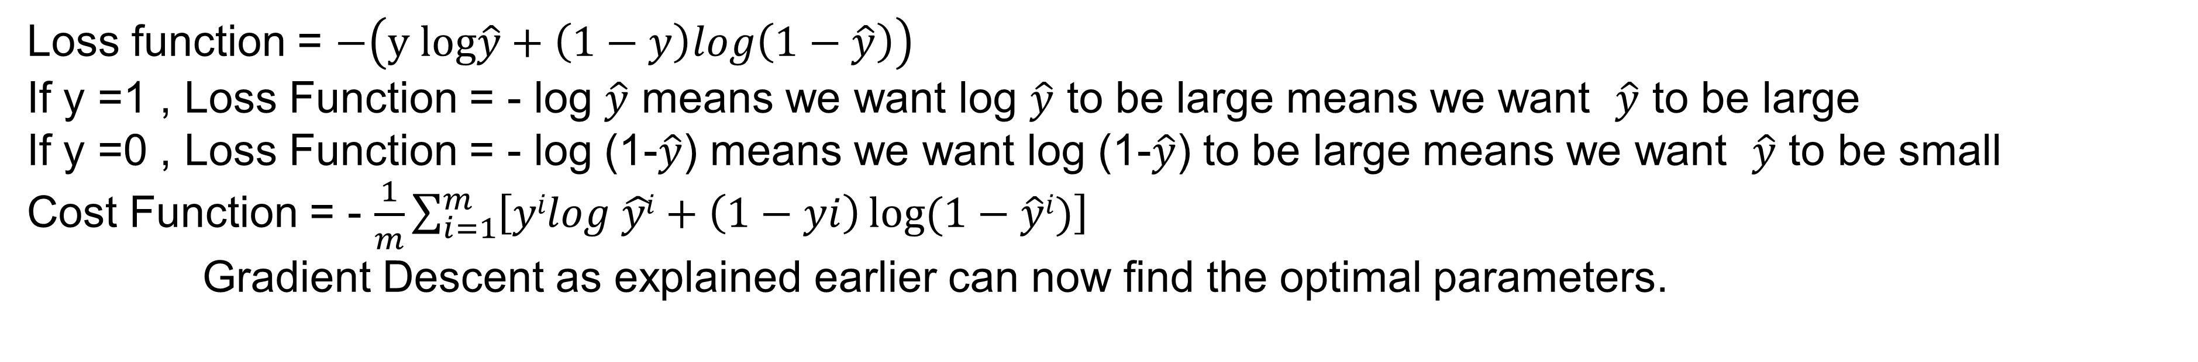
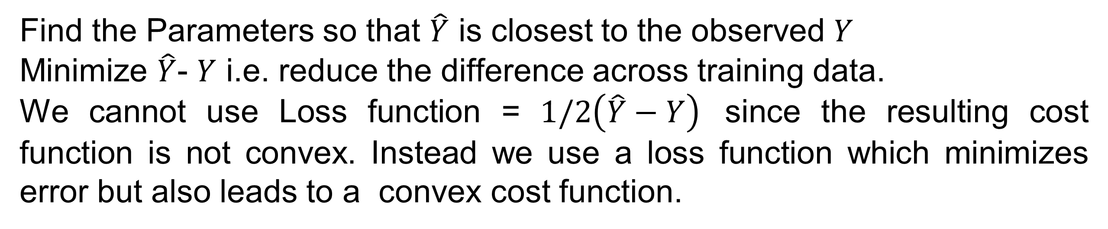
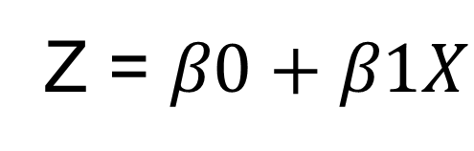
Binomial Logistic Regression
Sigmoid Function
In order to bound the output between 1 and 0 we transform the relationship using a sigmoid function
$\hat{Y}$= $\frac{1}{1+e^{−(z)}}$
Z = $β0+β1X$
If Z is very large, Y = 1/(1+0) = 1
If Z is very small (large negative number),Y = 1/large number = 0
Find the Parameters so that $\hat{Y}$ is closest to the observed $Y$
Minimize $\hat{Y}$- $Y$ i.e. reduce the difference across training data.
We cannot use Loss function = $1/2\left(\hat{Y}−Y\right)$ since the resulting cost function is not convex. Instead we use a loss function which minimizes error but also leads to a convex cost function.
Loss function = $−\left(y log\hat{y}+\left(1−y\right)log\left(1−\hat{y}\right)\right)$
If y =1 , Loss Function = - log $\hat{y}$ means we want log $\hat{y}$ to be large means we want $\hat{y}$ to be large
If y =0 , Loss Function = - log (1-$\hat{y}$) means we want log (1-$\hat{y}$) to be large means we want $\hat{y}$ to be small
Cost Function = - $\frac{1}{m}\sum_{i=1}^{m}{\left[yilog \hat{yi}+\left(1−yi\right)\log{(1−\hat{y}i)}\right]}$
Gradient Descent as explained earlier can now find the optimal parameters.

Slide 24
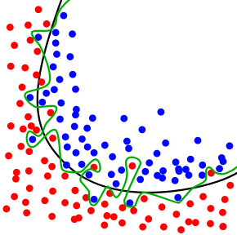
Overfitting
If we have very less features we will fit the data poorly in training as well as fail to generalize to new examples which results in Underfitting and we see high bias. The solution is to identify and include additional significant features. If we have too many features we may fit the training set very well but may fail to generalize to new examples which results in Overfitting and we see high variance.
Overcoming Overfitting
Try to reduce number of features
Manually select only significant features.
Automated feature selection algorithms
Regularization
Keep all features but reduce magnitude of parameters
Works well in case a lot of features contribute slightly to output

Slide 25
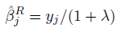
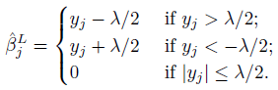
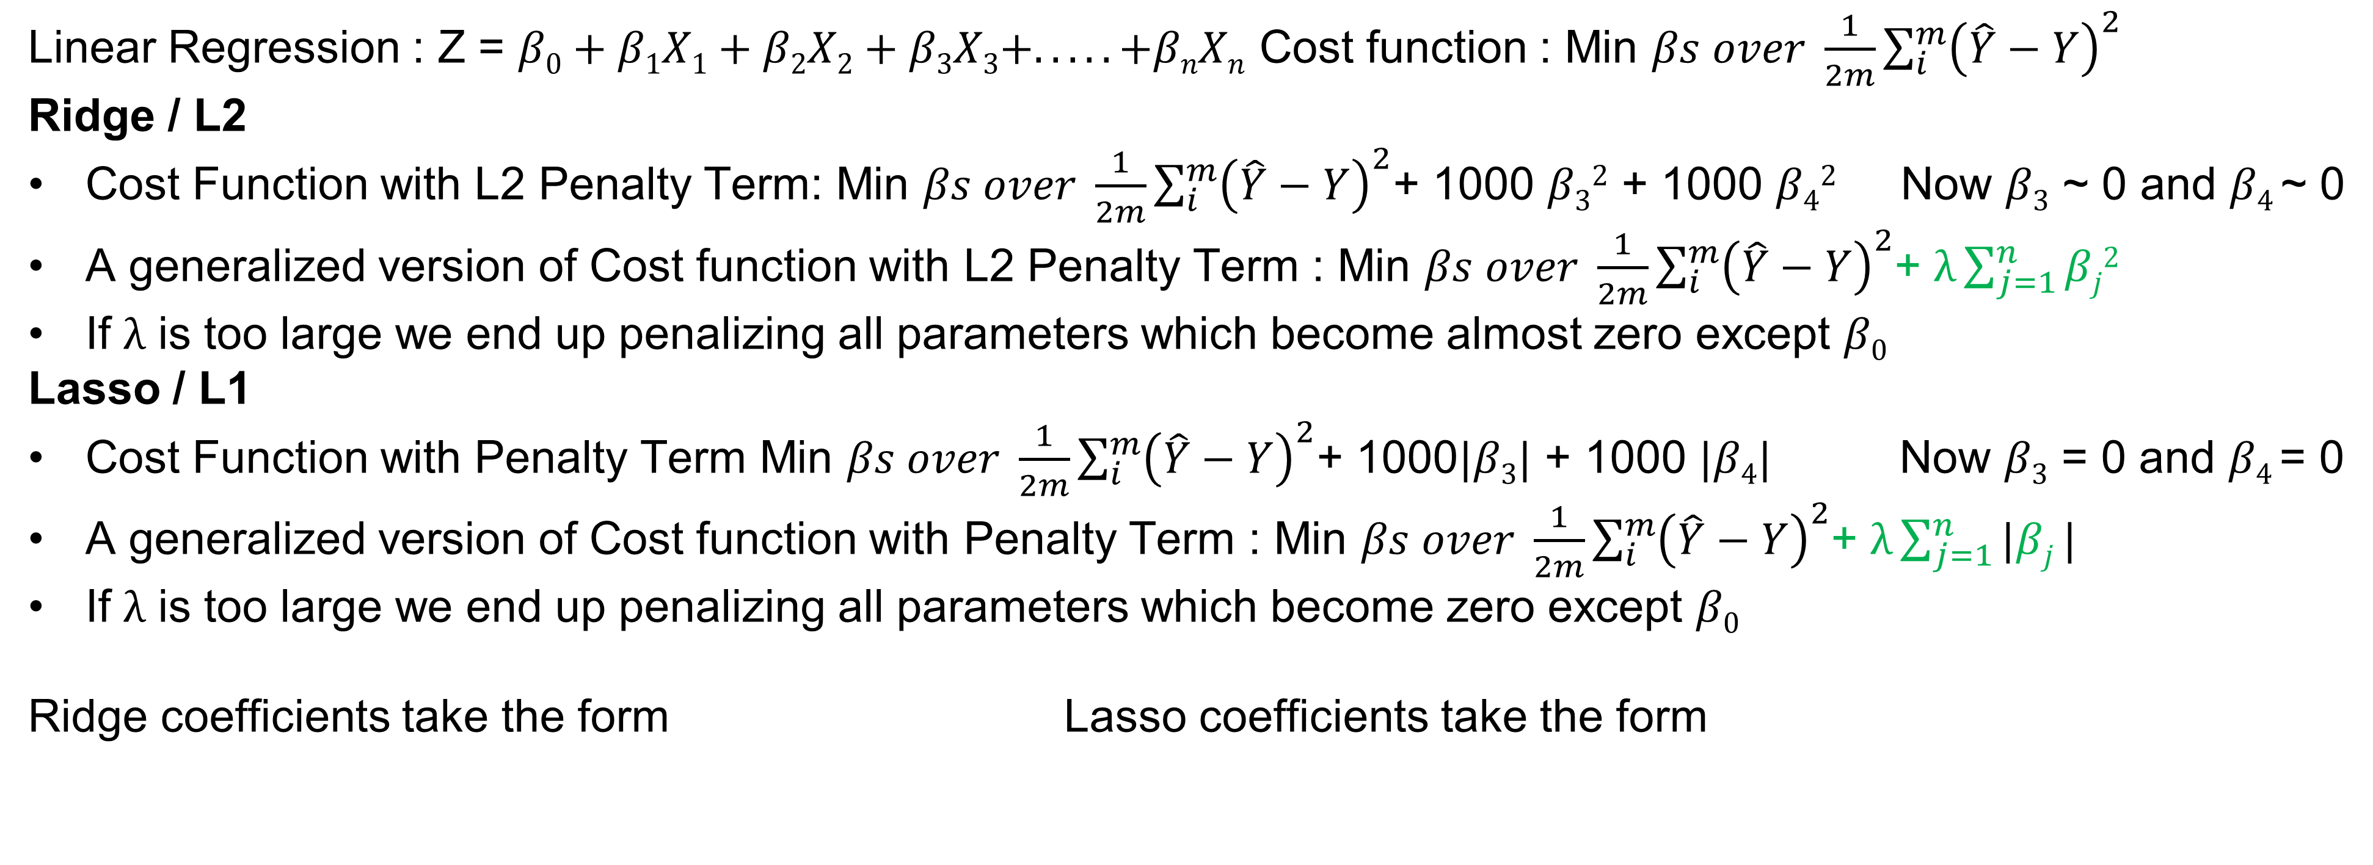
Regularization
Linear Regression : Z = $β0+β1X1+β2X2+β3X3+. . . . .+βnXn$ Cost function : Min $βs over \frac{1}{2m}\sum_{i}^{m}{{\left(\hat{Y}−Y\right)}^{2}}$
Ridge / L2
Cost Function with L2 Penalty Term: Min $βs over \frac{1}{2m}\sum_{i}^{m}{{\left(\hat{Y}−Y\right)}^{2}}$+ 1000 $β32$ + 1000 $β42$ Now $β3$ ~ 0 and $β4$~ 0
A generalized version of Cost function with L2 Penalty Term : Min $βs over \frac{1}{2m}\sum_{i}^{m}{{\left(\hat{Y}−Y\right)}^{2}}$+ $λ\sum_{j=1}^{n}{βj2}$
If $λ$ is too large we end up penalizing all parameters which become almost zero except $β0$
Lasso / L1
Cost Function with Penalty Term Min $βs over \frac{1}{2m}\sum_{i}^{m}{{\left(\hat{Y}−Y\right)}^{2}}$+ 1000$|β3|$ + 1000 $|β4|$ Now $β3$ = 0 and $β4$= 0
A generalized version of Cost function with Penalty Term : Min $βs over \frac{1}{2m}\sum_{i}^{m}{{\left(\hat{Y}−Y\right)}^{2}}$+ $λ\sum_{j=1}^{n}{|βj}|$
If $λ$ is too large we end up penalizing all parameters which become zero except $β0$
Ridge coefficients take the form Lasso coefficients take the form

Slide 26
Overview
Supervised | Artificial Neural Networks | Used for Regression and Classification
Supervised | Convolutional Neural Networks | Used for Computer Vision
Supervised | Recurrent Neural Networks | Used for NLP and Time Series Analysis
UnSupervised | Self Organizing Maps | Used for Feature Detection
UnSupervised | Deep Boltzman Machines | Used for Recommendation Systems
UnSupervised | Autoencoders | Used for Recommendation Systems

